Slide 1

SMART INDIA HACKATHON 2026
TITLE PAGE
Problem Statement ID – 26190
Problem Statement Title- Secure Digital
Document Management System for Legal
and Investigation Documents
Theme- Blockchain & Cybersecurity
PS Category- Software
Team ID-
Team Name - THE DEPLOYABLES

Slide 2



SDMS
A secure, intelligent, and case-centric platform for managing sensitive legal and investigation documents.
Problem & Solution Overview
Problems
Our Solution — SDMS
Scattered storage & uncontrolled sharing
Unauthorized access and lack of accountability
Tampering risk, no immutable history
Scanned docs not searchable; high manual effort
Case-centric repository with RBAC and cryptographic integrity checks
On-prem / self-hosted modular architecture
OCR + searchable text, AI-assisted extraction (human-in-the-loop)
Versioning, audit trails, and sharing controls

Slide 3
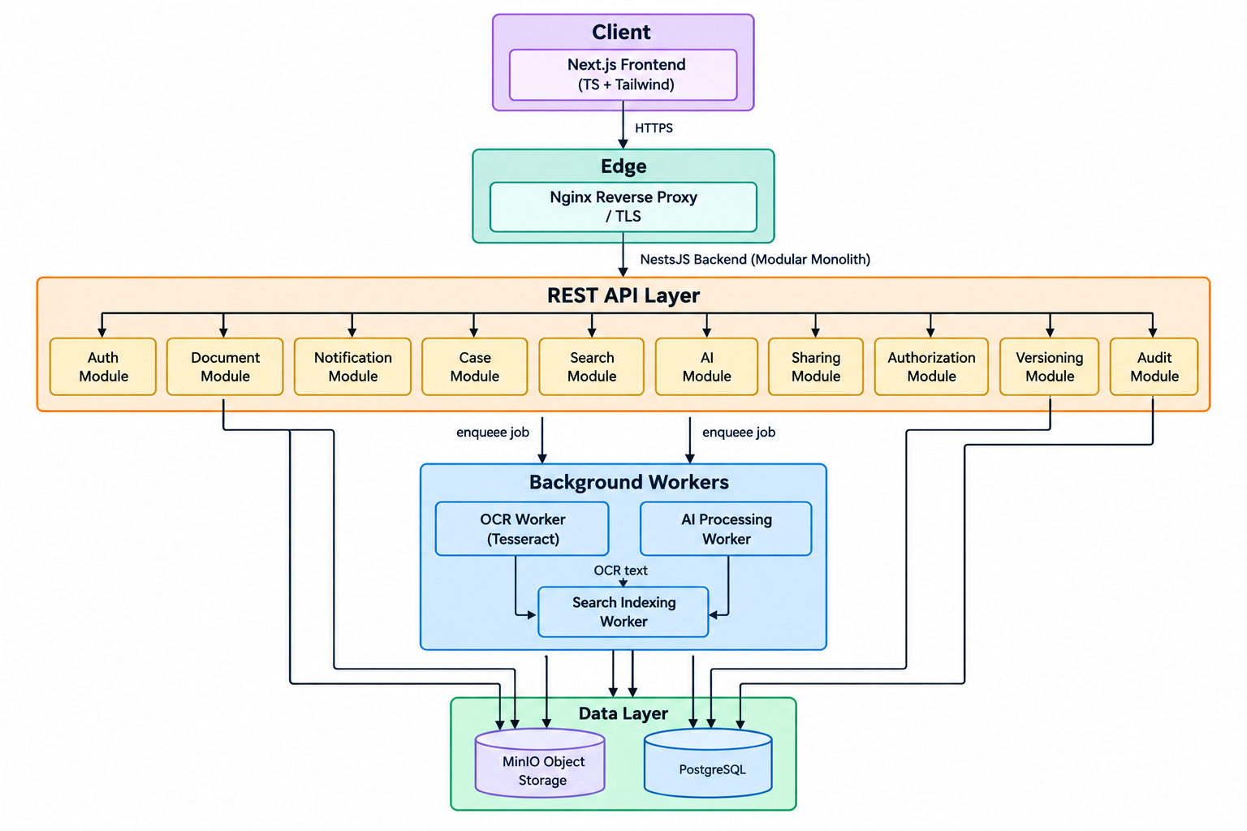


TECHNICAL APPROACH
1
2
Frontend
Backend & Storage
Next.js
• TypeScript
• TailwindCSS — role-aware UI for investigators and auditors
Node.js
PostgreSQL (metadata)
MinIO (objects)
Prisma ORM
3
4
Processing
Security
Tesseract OCR pipeline
AI services for summarization, classification & entity extraction (human-in-loop)
RBAC
SHA-256 hashing for integrity
Audit logs & version history
Architecture Diagram

Slide 4



FEASIBILITY AND VIABILITY
Feasibility
Key Risks
Mitigations
Built on proven open-source tech. Modular services enable incremental deployment.
Unauthorized access
OCR errors for low-quality scans
Large-scale storage & uptime
Hardened RBAC, encryption at rest/in transit, audit trails
Preprocessing & image enhancement to improve OCR
Object lifecycle policies, sharding, and monitoring

Slide 5



IMPACT AND BENEFITS
Primary Users
Law enforcement, prosecutors, courts, investigators, records managers, auditors
Key Benefits
Faster access to critical case records
Improved confidentiality and integrity
Clear audit trails for accountability
Reduced manual processing and better collaboration

Slide 6
RESEARCH AND REFERENCES
Bharatiya Sakshya Adhiniyam, 2023 — Sec. 61–63, electronic evidence (indiacode.nic.in)
NIST FIPS 180-4 — Secure Hash Standard, SHA-256 (csrc.nist.gov)
NIST/ANSI INCITS 359 — Role Based Access Control (csrc.nist.gov)
OWASP Top 10 — Web application security risks (owasp.org)
Tech stack docs: Next.js, NestJS, PostgreSQL, Prisma, MinIO, Tesseract OCR
CCTNS / ICJS, NCRB — background context only, not integrated (ncrb.gov.in)

